Slide 1

\ UGANDA INSTITUTE OF INFORMATION AND COMMUNICATION TECHNOLOGY
PHARMA-CONNECT: A PHARMACEUTICAL DELIVERY MOBILE APPLICATION
DEPARTMENT OF ICT AND ENGINEERING
SUPERVISOR:
EDISON NKURUNUNGI

Slide 2
PROJECT CODE : 68 BY
OKITOI SAM | 2024/ITB/WKD/1481
KASIRYE ALFRED SEMPAGI | 2024/ITB/WKD/0724
NANKUNDA OLIVIOUS | 2024/ITB/WKD/0681
NAMWANGA DAISY | 2024/ITB/WKD/1864/G
MUKWAYA ANDREW | 2024/ITB/WKD/1402/G
ACEKO MAUREEN | 2024/ITD/WKD/0727

Slide 3
PROJECT TITLE
PHARMA-CONNECT:
A PHARMACEUTICAL DELIVERY MOBILE APPLICATION

Slide 4
PROBLEM STATEMENT
Patients face difficulties accessing medicines due to manual processes.
Pharmacies have no real-time tracking or efficient logistics systems.
Paper-based prescriptions and deliveries are prone to errors and data loss.
The result: slow service, uncertainty, and poor customer satisfaction.
Existing Interventions: While mobile apps exist for various services, and informal orders happen via phone/WhatsApp, these are fragmented and non-specialized.
The Gap: There is a scarcity of integrated digital platforms dedicated to solving these specific pharmaceutical delivery challenges.

Slide 5
SCOPE
Geographical Scope: The study and pilot implementation are confined to Kampala District.
Technical Scope: It will include a customer-facing mobile application for pharmacy administrators.
Core functionalities include user authentication, prescription upload, order placement, basic inventory management, and order status tracking.
Functional Boundaries: Deep integration with existing legacy Pharmacy Management Systems (PMS) or third-party APIs for live GPS tracking is explicitly beyond the scope of this initial prototype.

Slide 6
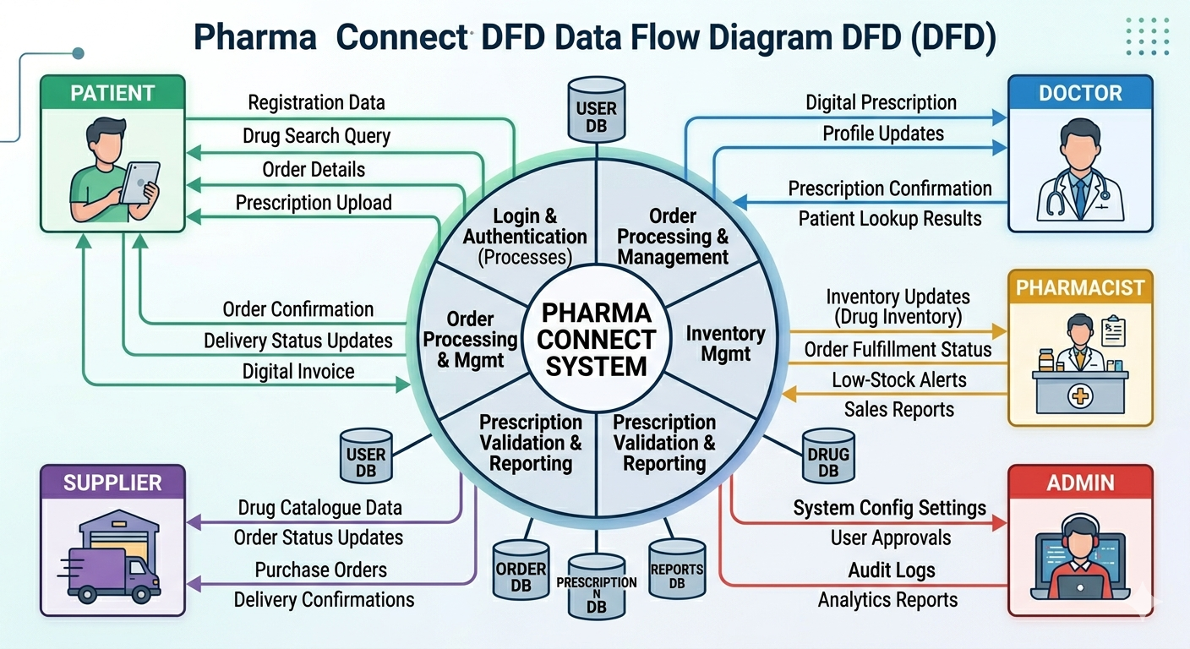
DATA FLOW DIAGRAM

Slide 7
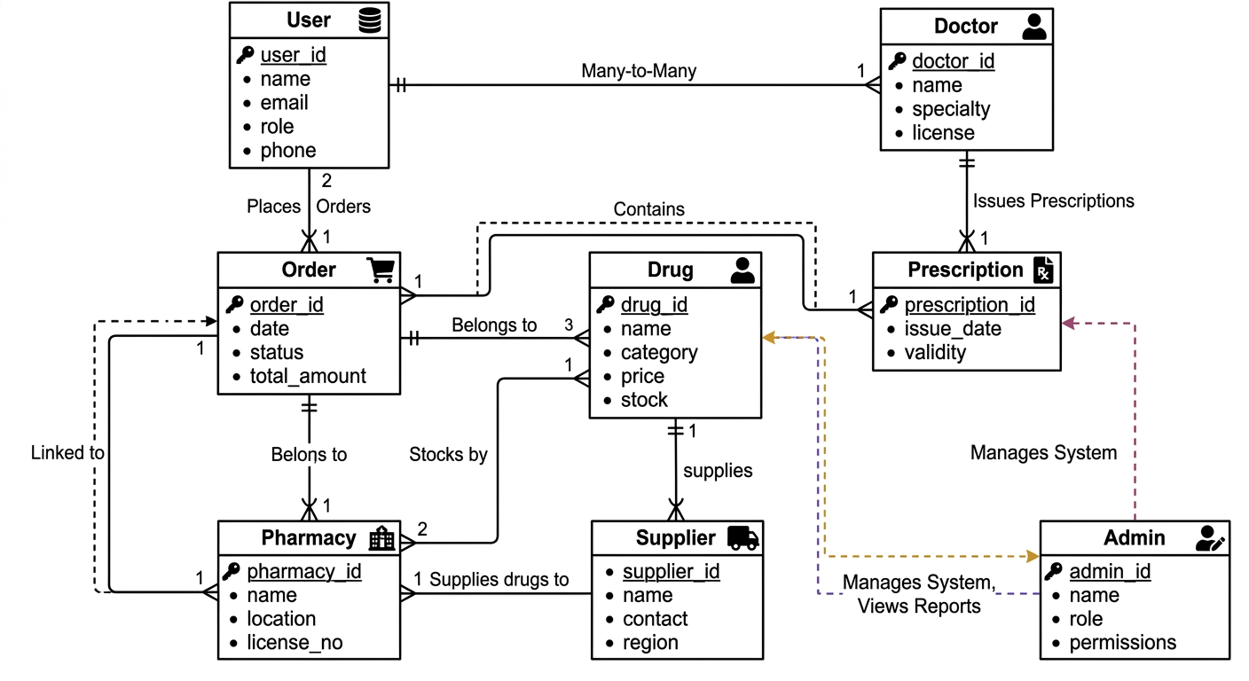
ENTITY RELATIONSHIP DIAGRAM

Slide 8
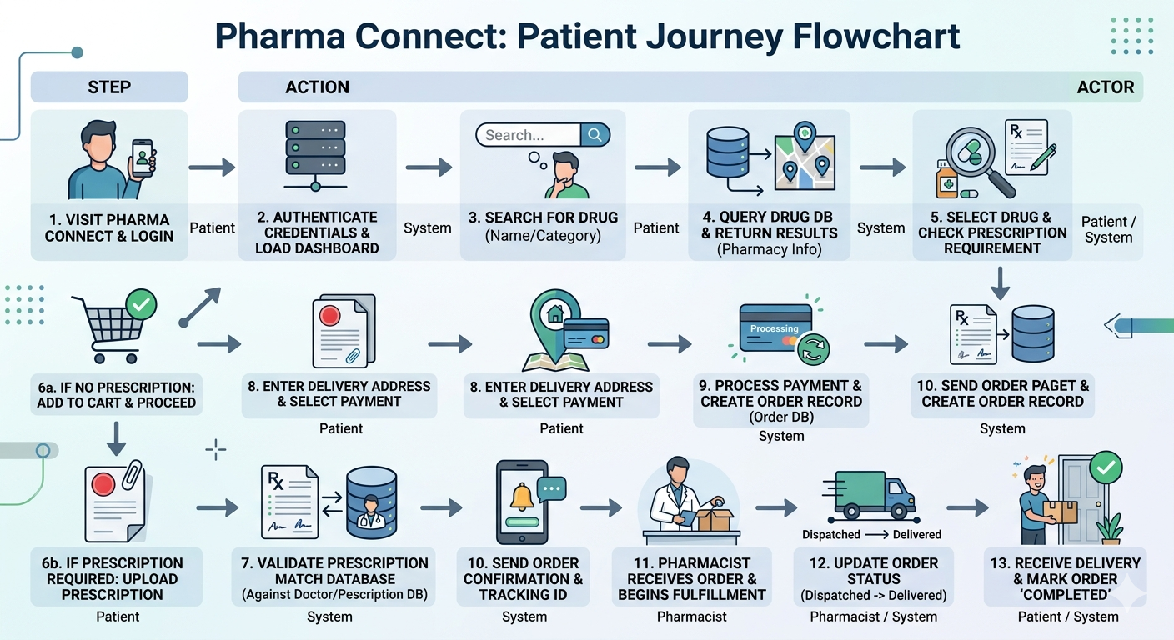
SYSTEM FLOW CHART

